Slide 1
HIEA Technical Forum: August 17-18, 2016
Information Modeling:
Foundation to Semantic Interoperability
“Recommendations for an Integrated Approach”
Steve Hufnagel, Session Discussion Moderator
CIMI-FHIM-SOLOR-CQF Integration, Current Report Version at: https://1drv.ms/w/s!AlkpZJej6nh_k9Nd0OKzwn3AM3huog
HL7 CIMI-FHIM Integration Task-Force
Preliminary Report
17 Aug 2016

Slide 2
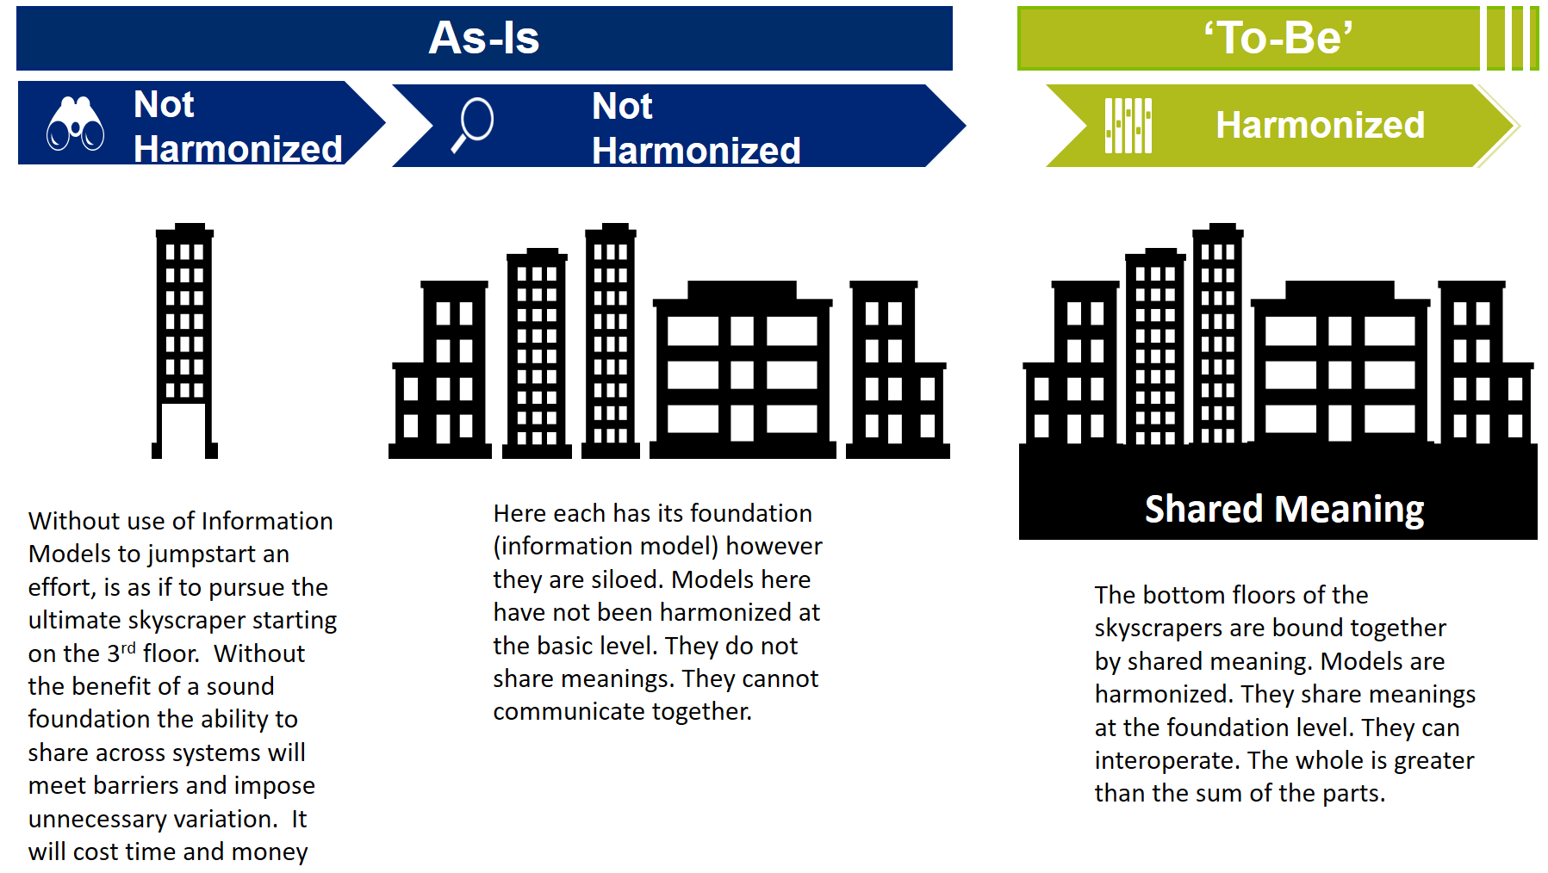
Executive Summary [Keith Campbell and The Open Group]

Slide 3
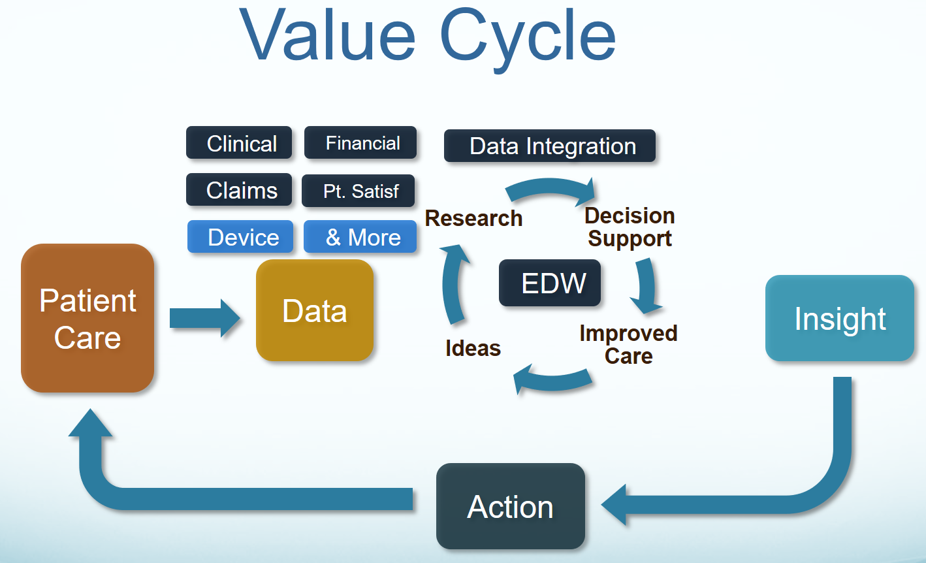
Goal and Benefits [Stan Huff]
Our goal is “To help people live the healthiest lives possible;” where, the foundation of a Learning Healthcare System is accurate, computable, data starting with the integration of CIMI, FHIM, SOLOR, CQF and other Information Models into a widely used HL7/ISO standard.

Slide 4
Discussion
Please bring up your questions, issues and suggestions!

Slide 5
Key Recommendations
CIMI curated HL7/ISO Common Logical Information Model (CLIM)
FHIM Domain Classes, CIMI/LEGO Detailed Clinical Models
SOLOR Terminology, CQF and other Info Models
Formalized CLIM governance/ Configuration Mgmt at HL7,
include Federal Partners and key contributors
Harmonize CIMI-FHIM-SOLOR-CQF Models and Tools
Opportunistically include other information models
Also harmonize with ISO Models
SHORT TERM: Use VA SOLOR terminology/ value set server
LONG TERM: Transition to NLM VSAC
inculcate CLIM (CIMI-FHIM-SOLOR-CQF) use.
Documentation, Training, mentorship, Outreach
“CIMI Practitioners’ Guide” student textbook

Slide 6
Discussion
Please bring up your questions, issues and suggestions!

Slide 7
“CIMI-FHIM Integration” Task Force Members
'Linda Bird' <lbi@ihtsdo.org>;
‘Bishop, Robert J.’ <Robert.Bishop2@va.gov>;
‘Keith E. Campbell’ <campbell@informatics.com>
'Richard Esmond' <richard.esmond@gmail.com>;
'Jay Lyle' jay.lyle@jpsys.com;
'Stan Huff MD' Stan.Huff@imail.org;
‘Stephen Hufnagel’ SHufnagel@ApprioInc.com;
'Galen Mulrooney' <Galen.Mulrooney@JPSys.com>;
'Claude Nanjo' <cnanjo@cognitivemedicine.com>

Slide 8
Technical Recommendations
Change/Stabilize CIMI Core Reference Model ASAP
Integrate Models and Tools to extend the utility of these assets
A clean separation of clinical model semantics using SNOMED, LOINC and RxNORM
Use the VA SOLOR Terminology server with a sandbox development server, with a long term goal to transition to VSAC
Harmonize all CIMI integrated models and tools with the FHIR resource “logical model” to generate or map-and-gap consistent FHIR Resources, Extensions and Profiles.
Demonstrate the Viability of CIMI-FHIM-SOLOR-CQF and other Information Models Integration Via Pilots

Slide 9
Discussion
Please bring up your questions, issues and suggestions!

Slide 10
Thank You
CIMI Co-Chairs:
Linda Bird BIT, IHTSDO, lbi@ihtsdo.org
Galen Mulrooney, FHA and VA, galen.mulrooney@jpsys.com
Harold Solbrig, Mayo Clinic, solbrig.harold@mayo.edu
Stanley Huff, Intermountain Healthcare, stan.huff@imail.org
Members of the following SDOs have participated in CIMI:
IHTSDO, POC: Linda Bird BIT
HL7 Work Groups (PC, CDS, CIC, EHR, SOA, Vocab)
The Open Group Healthcare Forum, Jason Lee POC
ISO/CEN, POCs: Gerard Freriks, William Goossen, Gary Dickinson
Federal Agency staff and contractors have participated in CIMI:
Department of Defense
Veterans Administration
Interagency Program Office
ONC and its Federal Health Architecture
Members of the following Healthcare Organizations have participated IN CIMI:
Intermountain Healthcare
PenRad, Inc.
Results4Care
Faculty, Staff and students from the Following Universities have participated in CIMI:
The University of Utah

